Slide 1
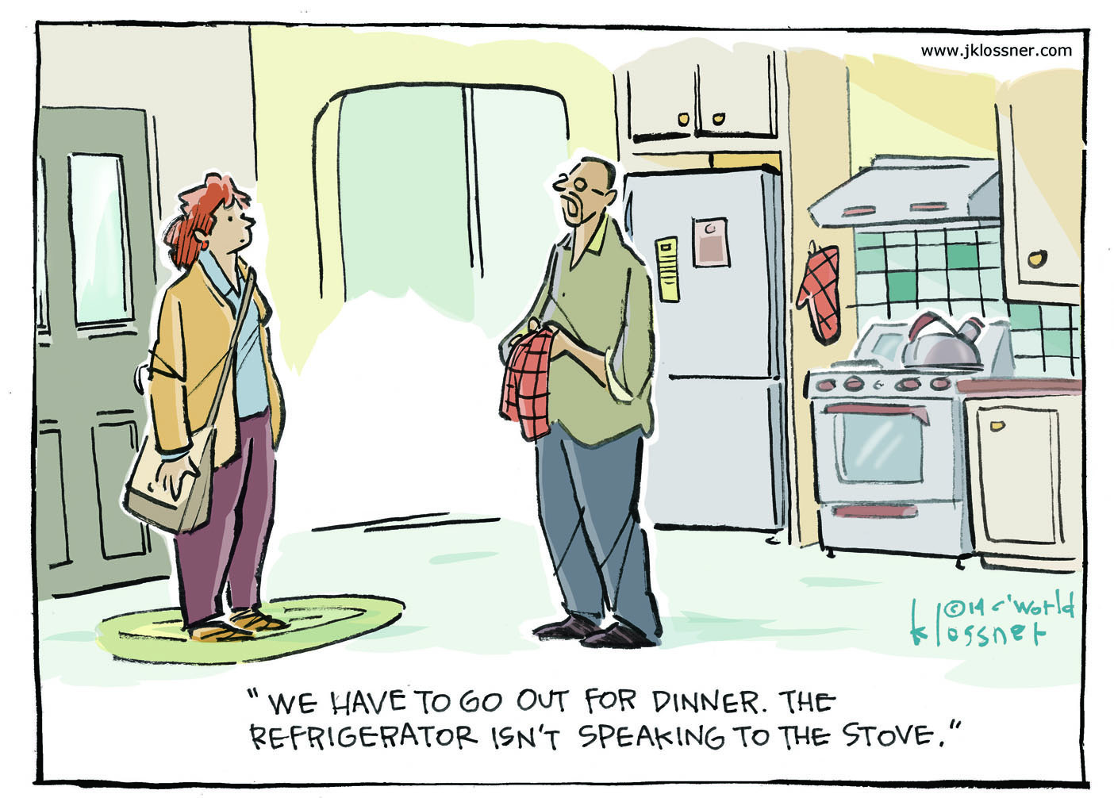

Slide 2


Pervasive Computing aka “The Internet of Things”
With slides contributed by Uğur Çetintemel

Slide 3
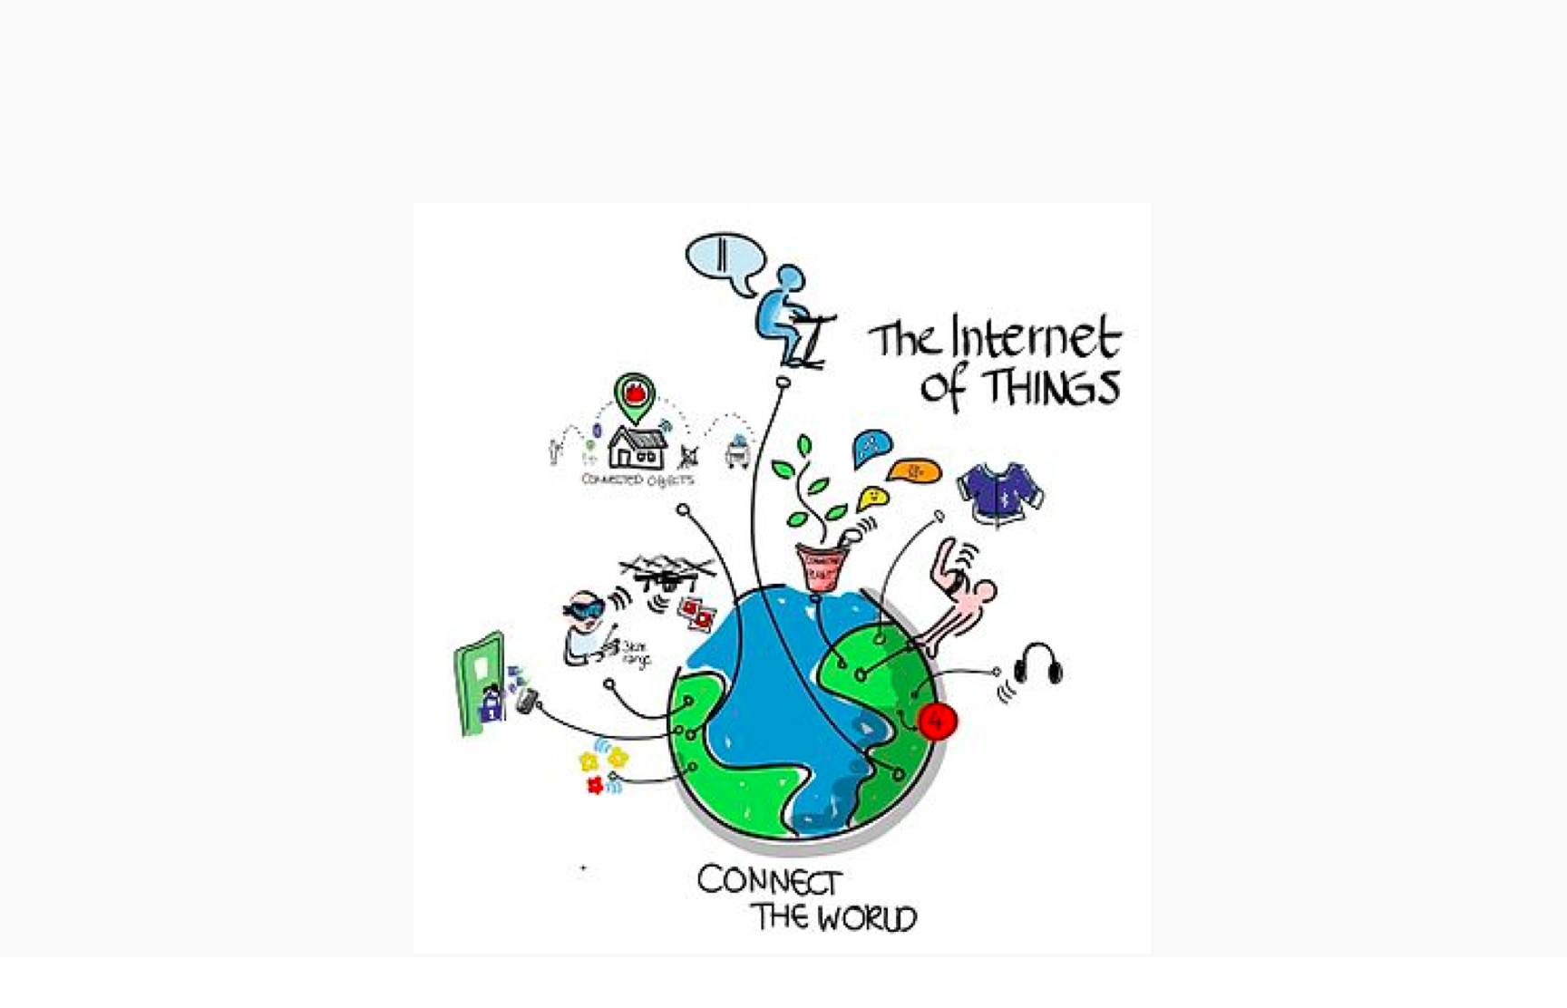
The Internet of Things - IoT

Slide 4
What is Pervasive Computing / IoT?
Numerous, easily accessible, often inconspicuous computing devices and sensors/effectors
Often mobile or embedded in the environment
Connected to an increasingly ubiquitous network structure
In some cases, Connected to existing systems

Slide 5
For the IT Industry
Pervasive Computing is rapidly emerging as the next generation in computing
Failure to act upon this trend may be a very costly
If history holds, the innovative firms which establish a critical mass early in the generation life cycle are the ones with superior returns on investment

Slide 6
For the Computer User
Simplicity of use
Ubiquitous access
Minimal technical expertise
More intuitive interaction
Reliability

Slide 7
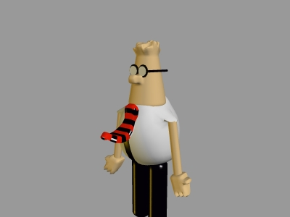
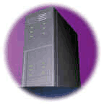
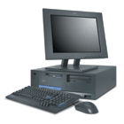
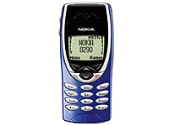
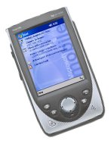

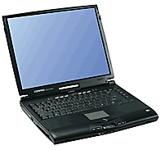
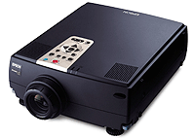
Trend towards Pervasive Computing
size
one computer, many people
one computer, one person
one person, many computers
smart dust
number

Slide 8
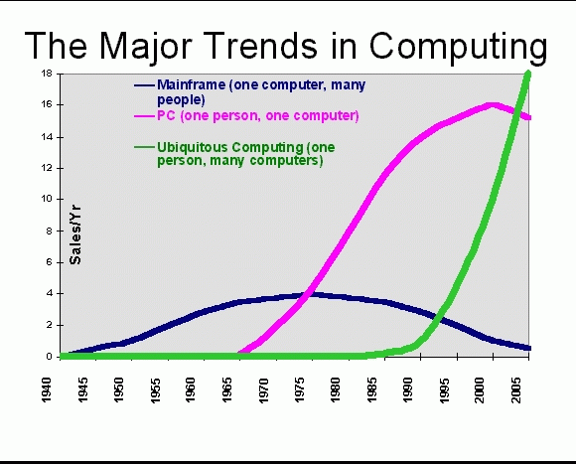
Sales Confirm this Trend!

Slide 9
Growth of Internet Connectivity
machine-to-machine
Embedded
Internet
people-to-machine
Mobile
Internet
people-to-people
WWW
Email
research
network
Internet timeline

Slide 10
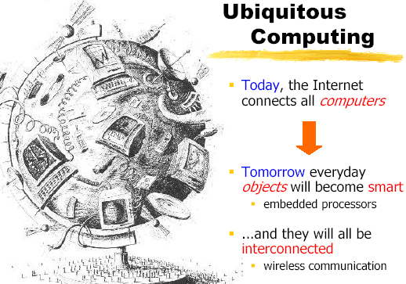
Where are we going?
Today
“all computers are connected via the Internet”
Tomorrow
“everyday objects will become smart”
embedded processors
“...and they will be increasingly interconnected”
wireless communication

Slide 11
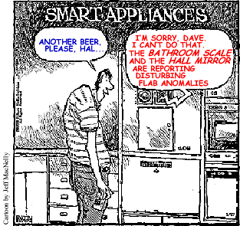
Smart Everyday Objects, Interconnected…?

Slide 12
The Real Thing
Natural technology trends
Computation is becoming essentially free
Communication is becoming ubiquitous
Smart devices
Huge numbers of computing devices in the world
What are we doing with them?
Modes of operation
Programs controlling other programs
Human-in-the-loop: “computing should be only as visible as I desire; no more, no less...”
Content Delivery
Anything I am entitled to see or hear, always available

Slide 13
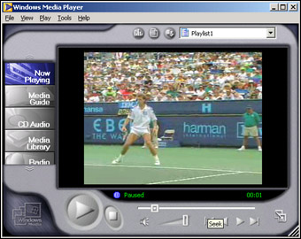
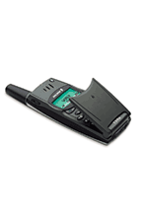
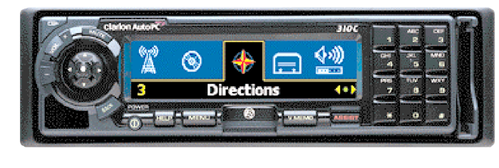
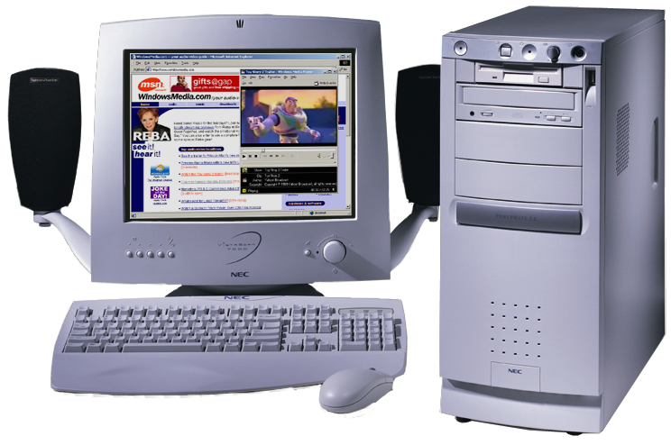
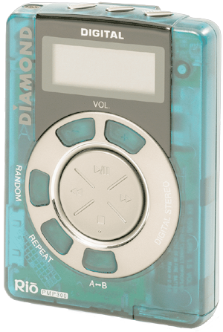
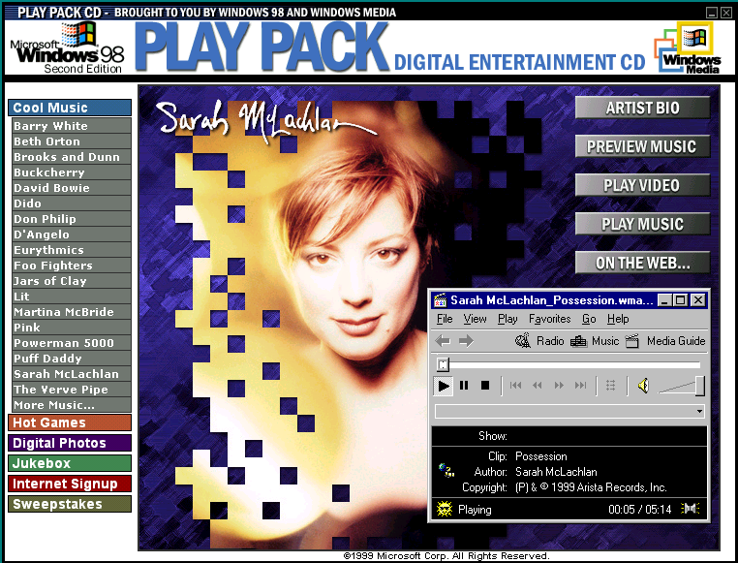
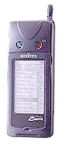
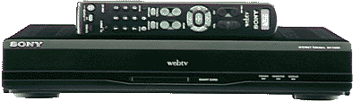
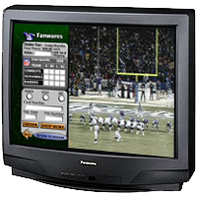
The Multimedia Environment
Live Content
License
Server
Download & Play
Streaming
Live Feed
On-demand
Content
UNICAST/
MULTICAST
Media Encoder
Media Services Server
Streaming from a
Web Server)
Media Players PC, Hand-held, STB
TV, DVR
Stored Content
Authoring
Distribution
Playback
And, Interactivity!

Slide 14

Digital Media World
Many devices
Wired or wireless
Access from anywhere
Intuitive User interface
Personalized delivery
What you want, when and where you want it..
Content Rich Services

Slide 15
Content is driving the imperative!
Bandwidth (wired and wireless) will continue to increase at decreasing cost
Computing power will continue to grow at decreasing cost
Bandwidth and computing power are quickly becoming (or have already become) taken for granted and commoditized in the value chain
CONTENT that takes advantage of bandwidth and computing power will drive the value chain in the future and justify future investments in broadband capacity

Slide 16
Mobility
Consumers increasingly want to access any content that they are entitled to receive anywhere, anytime on an increasing number of devices, on their schedule, not someone else's
Example: Time shifting using DVRs (TIVO) is the way to watch TV at home.
The current trends in wireless broadband (4G/5G) enable unicasting/broadcasting of high quality digitally compressed content at over 100Mbits/sec to consumers who are traveling at speeds as fast as 120mph

Slide 17
Mobile is taking over
“The Numbers Are Clear: Mobile Is Taking Over The World
The unstoppable growth of mobile connectivity is linking virtually the entire human population - and that will re-construct how people around the world engage in shopping, banking, entertainment, work, healthcare and learning.”
6.8 Billion Subscriptions !!

Slide 18
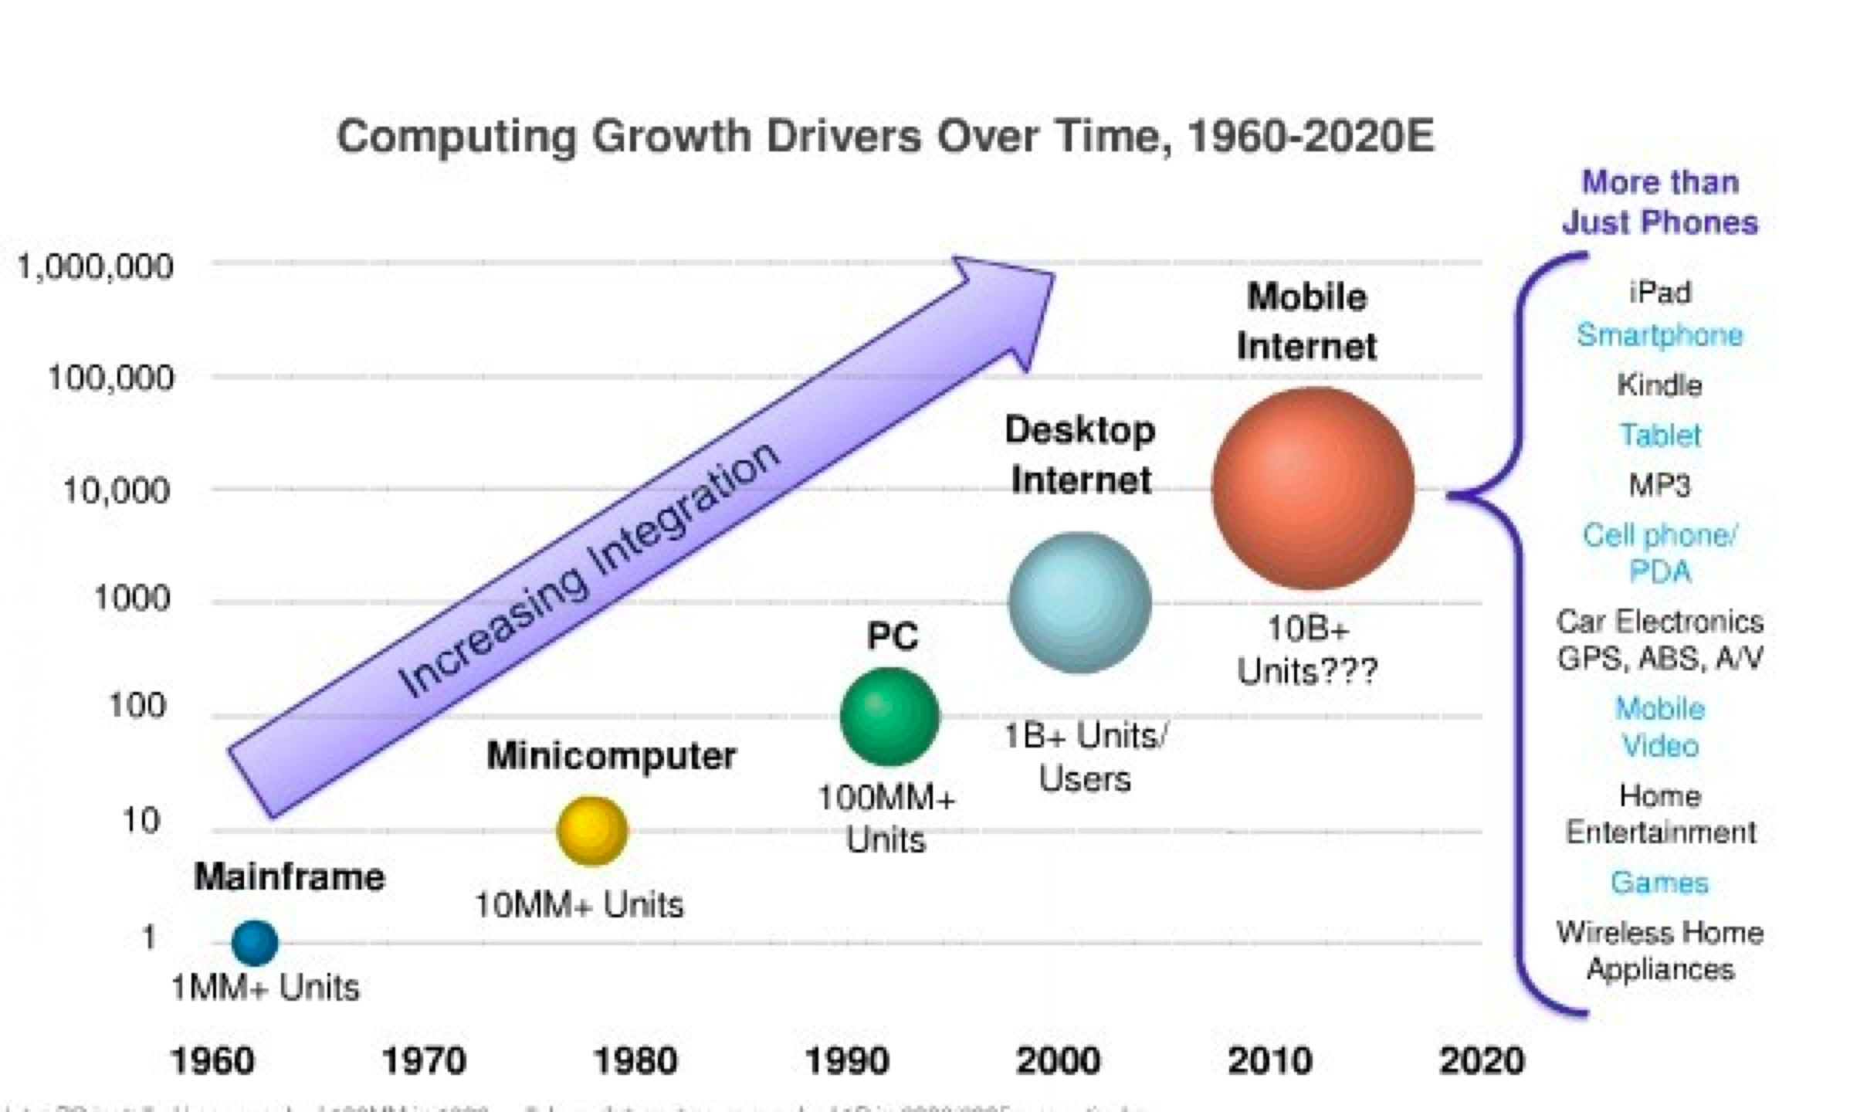
Computing Growth Drivers

Slide 19
How is all these possible?
Moore’s Law (1965)
Improved communications technology
IPV6
Decreasing Cost…driven by
#1 above
and massive adoption

Slide 20
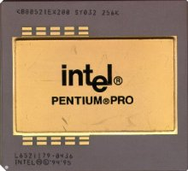
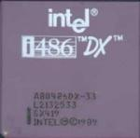
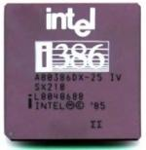
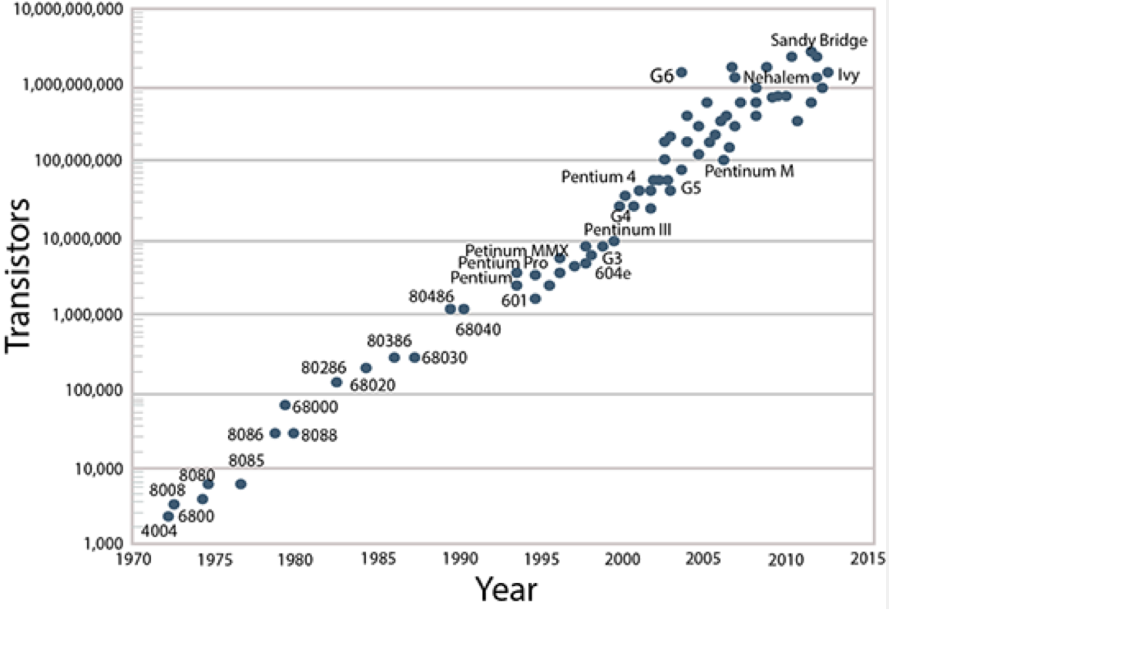
Transistors per Integrated Circuit Processor

Slide 21
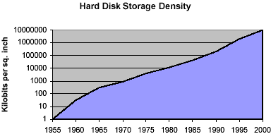
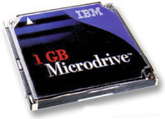
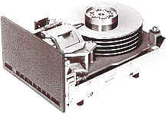
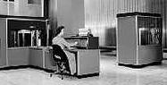
Storage Density

Slide 22
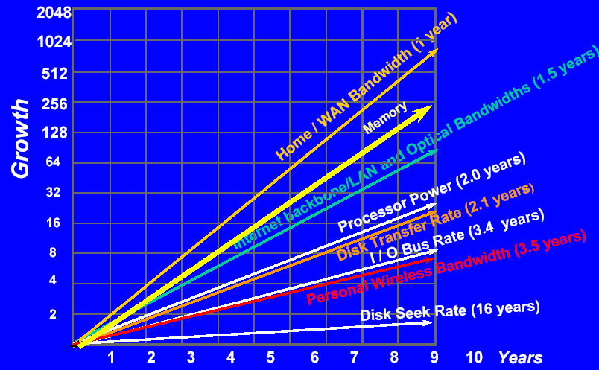
Growth Speed of Key Technologies Obeys Moore’s Law

Slide 23
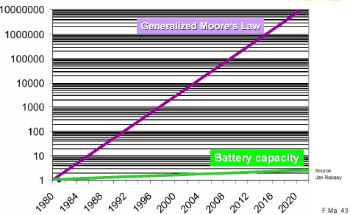
Not Everything Obeys Moore’s Law
Power Consumption, not speed, is a key issue for future processor design!

Slide 24
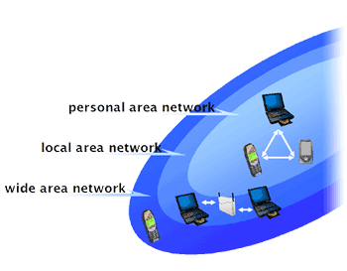
Progress in Communication Technologies
Fiber optics: Gbit/s to Tbit/s
Wireless
WAN: mobile phone: GSM, GPRS , 3G, 4G, 5G
LAN: 802.11, HiperLan (> 10 Mbs)
Personal Area Networks (PANS): Bluetooth (700Kbs), IR
Body area networks (2400baud)
Powerline technique
coffee maker “automatically” connected to the Internet

Slide 25
Example: Smart Dust
Autonomous sensing and communication in a millimeter – “dust motes”
Sensors for temperature, humidity, light, motion
Direction, tilt, video, orientation
With bidirectional radio or laser + battery
Costs < $1
Typical Applications
Defense related battlefield sensors, motion detectors etc.
Inventory control on boxes which communicate with crates, trucks, plane etc to tell you where they are
Product quality monitoring – vibration, humidity, overheating

Slide 26
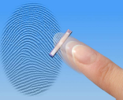
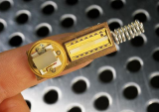
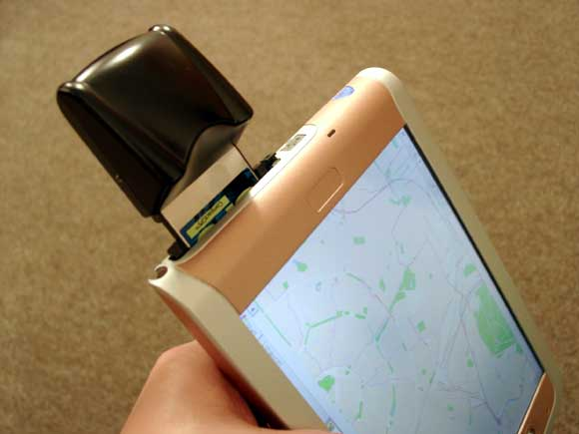
Sensor Technology
Miniaturized cameras, microphones
Fingerprint sensor
Radio sensors (RFID)
without power supply
Location sensors
GPS
…

Slide 27
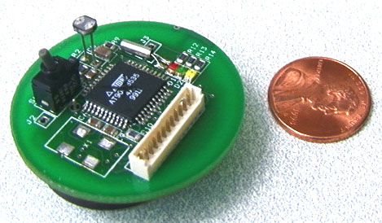
Example: Motes
Manufactured by Crossbow
http://www.xbow.com
Processor: 4MHz
RAM Memory: 128 Kbytes
On-Board Flash: 512 K bytes
Radio: 916 Mhz, 52K bps
Antenna: On-board, optional external
TinyOS from Berkeley

Slide 28
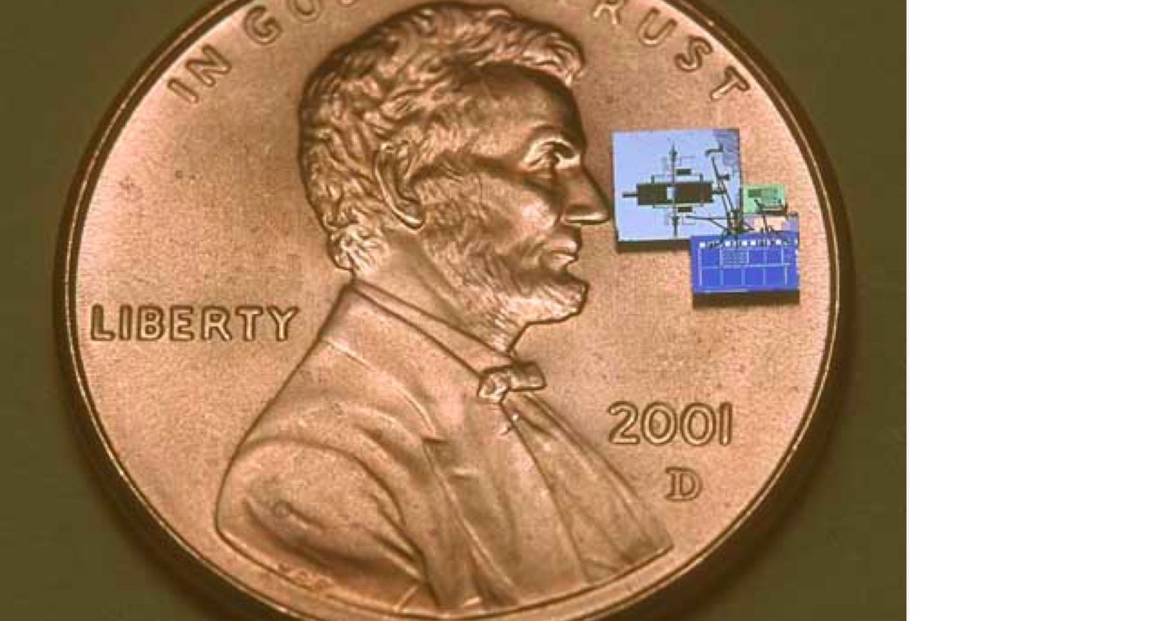
Getting smaller all the time!

Slide 29
Computer Science Challenges
Almost all domains are affected
systems infrastructures, networking, security, user interfaces, programming paradigms, embedded systems, AI, speech recognition, …
Many new research and technical challenges emerge!

Slide 30
From the very large to the very small…….

Slide 31
Cloud Computing
While computing is getting smaller, it’s also getting BIGGER!
Cloud Computing is “Timesharing for the 21st Century”
Provides shared resources at “lower” cost….maybe

Slide 32












Commercial Cloud Computing
A new paradigm for delivery and consumption of computing resources
Leverages distributed processing and network infrastructure
Early in the maturity cycle
Lack of standardization
Industrial strength capabilities vary
Security, availability, auditability, isolation

Slide 33
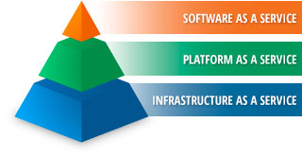

Slide 34
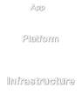
Infrastructure as a Service (IaaS)
Fundamental computing resource provisioning
Server hardware, storage, networking, OS, DB, CPU, Memory, Virtual Machines
Service provider owns assets, is responsible for facilities, running and maintaining system solution
Commercial Industry
All computing resources combined as a single resource pool allocated on demand
Examples:
Amazon Compute Cloud (EC2)
Amazon Simple Storage Service (S3)
IBM SmartCloud Enterprise
DropBox

Slide 35
Platform as a Service (PaaS)
Delivery of a computing platform and solution stack as a service
Commercial Industry
Enables users to create cloud based applications
Utilities, network, security, storage, cpu, server, OS combined as part of a platform via a higher layer of utilities, an encapsulation of IaaS capabilities
Examples:
Google AppEngine
Microsoft Windows Azure
Microsoft Office 360

Slide 36
Software as a Service (SaaS)
Applications available to service consumers via browser-based interfaces
Applications run on cloud infrastructure
On demand software delivery model
Commercial Industry
Service Provider provides data center, servers, OS, software, apps
Examples:
Salesforce.com
Google Apps
Amazon PayGo POS
Microsoft Office 360
Amazon Web and Retail Services

Slide 37
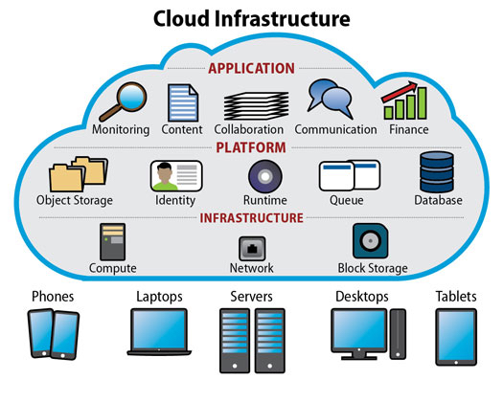

Slide 38
Millionaire!!

Slide 39
Ubiquitous Applications that we rarely think about….

Slide 40
Traffic Control
Red Light Alert and Detection
Speeding Enforcement
Electronic Crossing Guard
Bike Path Alert Systems
Railway Crossings Alert Systems
Air Traffic Control !!!

Slide 41
Environmental Monitoring
Remote sensors which monitor environmental data such as Temperature, Humiditiy, Wind speed, Toxicity levels in Water, etc
Video Monitoring of protected coast land with automatic detection of anomalies
Connected to a wide area network with data recording in real time at centralized locations
Environmental networks are often Radio Frequency based using satellites or other RF systems

Slide 42
Non Invasive Medical Monitoring
Much research and development involving non invasive sensors that allow remote patient monitoring
Blood pressure, blood chemistry, heartbeat, tumor detection, etc
Data is sent via the Internet to diagnostic centers which can process and generate alerts based on abnormal readings

Slide 43
Location services
Mobile 911 Location services are rolled out nationwide.
Global Positioning System direction services
OnStar, Google Maps, Waze, etc.
Personal location services
Children
Elderly

Slide 44
Logistics Management
RFID (Radio Frequency Identification Devices) enable retailers to track goods from their point of manufacture all the way to the store shelf
RFID tags embedded in living creatures enable immediate identification together with examination of medical history
RFIDs now permit automatic monitoring and tracking of practically any item that carries them

Slide 45
Smart Appliances
Refrigerators and cabinets that keep inventory of food by reading barcode labels or RF ID tags
Order food automatically via the Internet
Keep track of expiration dates
Automatically create recipes based on food you have
Calculate Caloric intake based on consumption
Stoves and ovens that automatically cook food perfectly every time based on the food weight and ID

Slide 46
Smart Working and Living Spaces
Automatic and optimal control of heat, light and other environmental factors
Sensors and audio to guide sight impaired or handicapped occupants
Emergency notification to you wherever you are!
Ability to see what the kids are doing when you are away!

Slide 47
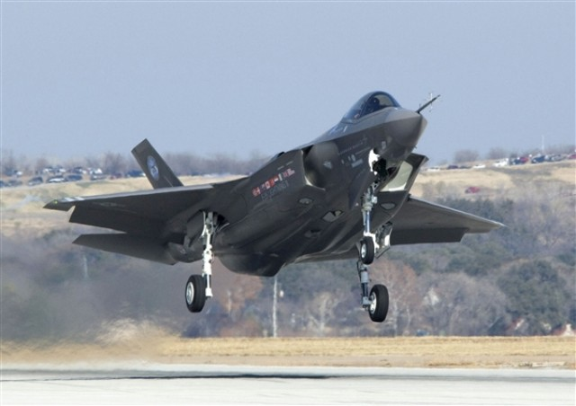
F-35 Strike Fighter
8 Million Lines of Code!

Slide 48
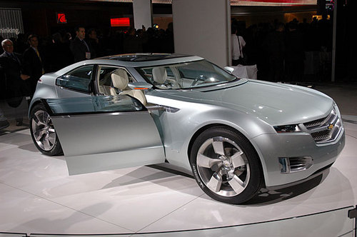
”Chevy Volt - More
Software Than Car”
- Manufacturing Business Technology 11/2
“Powered by a “system of systems,” software makes up
over 40 percent of the car -- up from just 5 percent in the
1980s -- which features over 100 electronic controllers, 10
million lines of code, and even its own IP address.”

Slide 49
8 million lines of code
10 million lines of code
What could possibly go wrong?

Slide 50
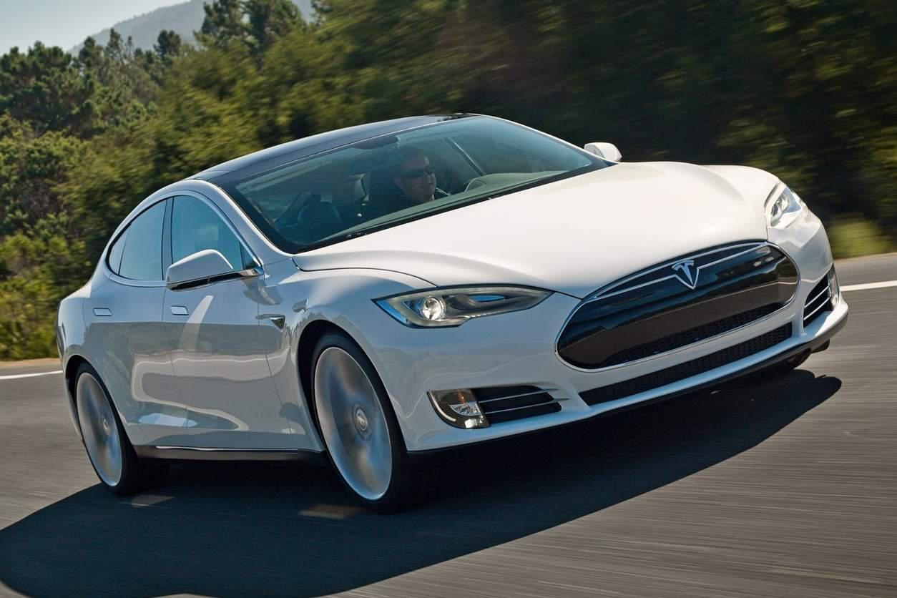
The Tesla Model S
52 Embedded Processors!
100 percent of new cars will be internet connected by 2023

Slide 51
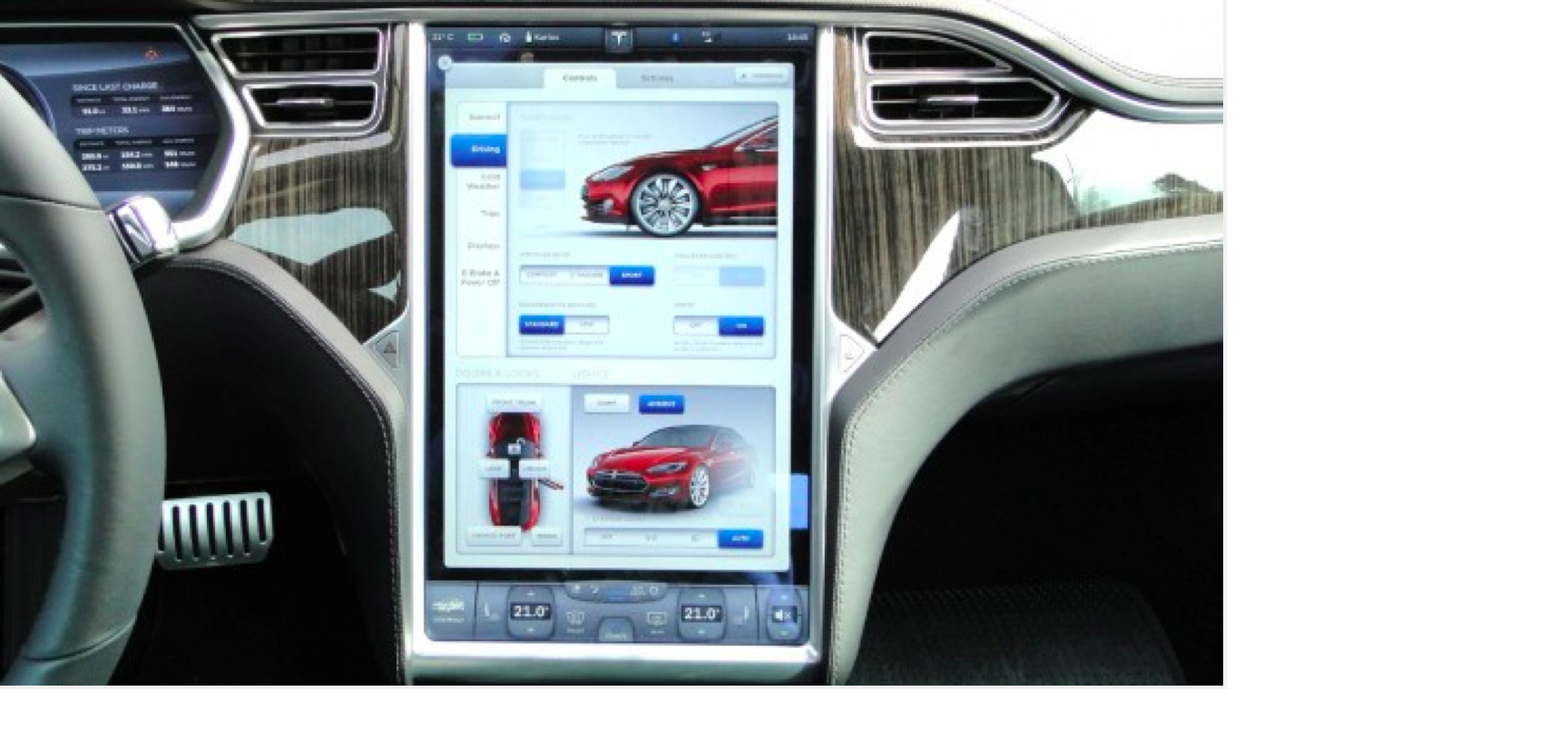
Look Ma, No buttons!
Controlled via a 17 inch Touchscreen and downloaded over the Internet

Slide 52
Homeland Security
Video monitoring of borders and coastland
Automatic alerts to local authorities of intrusions
Possible Identification based on physical characteristics
Monitoring of phones, internet traffic
Big constitutional issues concerning privacy, etc

Slide 53
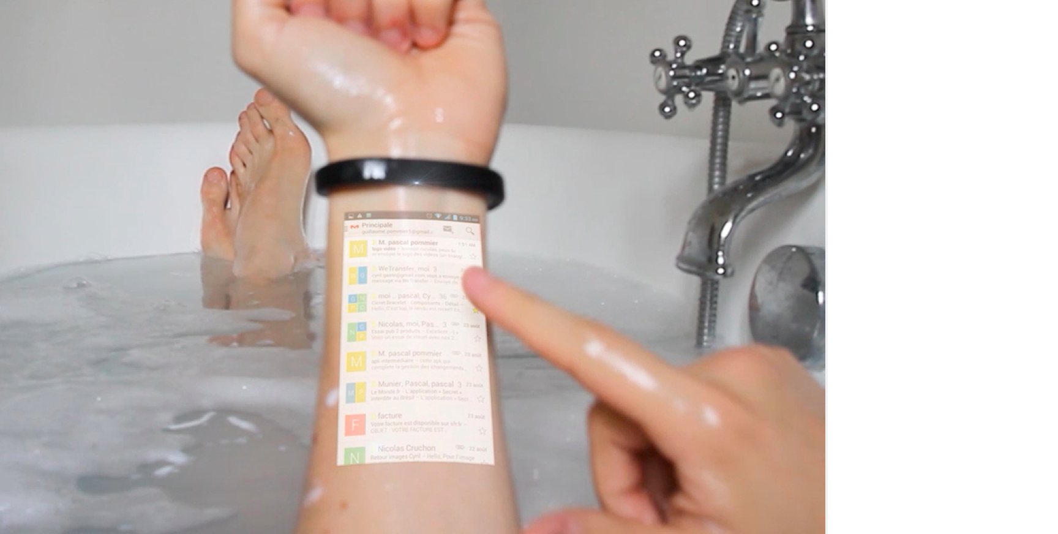
Cicret Digital Bracelet
Project and operate your cellphone on your arm via a wireless bracelet

Slide 54
The Body Electric (BioElectronics)
Computing Power Over or Under the Skin
Digital “skin” made of silicon transistors that are grafted to the body
Capable of monitoring and wirelessly reporting a wide range of bodily functions and chemistry
The Cyborg era has arrived!
http://www.youtube.com/watch?v=KAx8QUaKG18

Slide 55
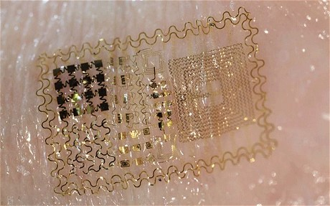
Digital Skin !

Slide 56
What are some of the possibilities with Digital Skin?
Automatic injection of medicines
Monitoring of vital signs
Blood Sugar Levels
Heart Rate
Oxygen Levels
Neurological events and seizure control
Cancer Detection!!!
To Name a Few!
All automatically uploaded via wireless to the Internet and to your Doctor’s Patient Records System!

Slide 57
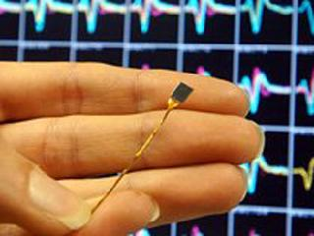
Researchers at Brown University hope that devices implanted
in the brains of quadriplegics will allow them
to to move a computer cursor by using their minds
AP photo / Chitose Suzuki
The BrainGate Neural Interface System consists of a silicon
wafer with 100 electrodes and a wire that will extend outside the skull.

Slide 58
Brain Gate Demo

Slide 59
Bio Computing
Use of molecules, DNA and nano materials to create computing structures based on organic materials
https://www.youtube.com/watch?v=M9A2F1SYdjw

Slide 60
the bottom line
It is increasingly easy to capture, store, search and share information of practically any sort as a result of the evolving digital revolution
The cost continues to decrease
The performance continues to increase
This ability has both benefits and significant dangers
We should all be aware of what is happening and how it will affect our lives

Slide 61
the bottom line
Pervasive computing/IoT is one of the largest areas of research, development and activity
It affects all of us
We participate in it without even knowing it!
Every time you use your cellphone, touch a keyboard, swipe a card, or walk down the street you are a participant.
One day you might be able to do it just by thinking it!

Slide 62
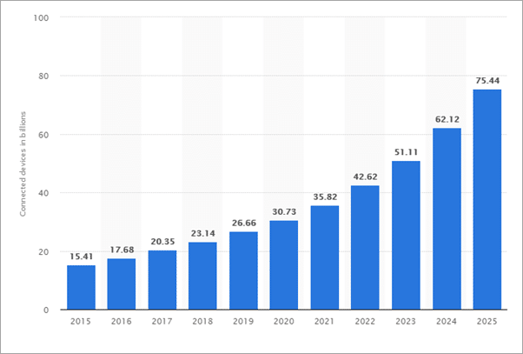
7.6 Billion Humans…. 76 Billion IOTDevices?

Slide 63
Some of the Latest Good and Not So Good IoT ideas…...

Slide 64
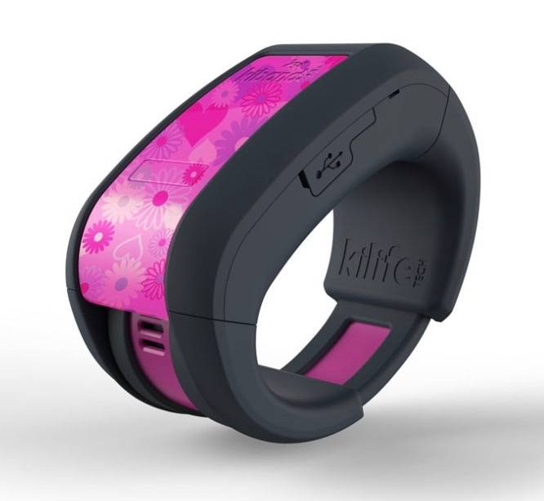
KiBand – kid tracking bracelet

Slide 65

Dubstein

Slide 66

Kafon Mine Drone

Slide 67

Robotic Suitcase that follows its owner

Slide 68

The Kiss Phone

Slide 69
Computer Controlled TRASH receptacle

Slide 70
Remember one thing however….
The more IOT devices we use,
The more vulnerable we are to attack!

Slide 71
QUESTIONS?
Thank you for taking CS2!!!.. We hope you enjoyed it!

